Slide 1
TECHNICAL RESEARCH PROCESS
Reducing Fuel Waste in Azul Operations
A data-grounded reconstruction of the analysis pipeline: problem -> data -> filters -> sweet spots -> route swapability -> seasonal decision engine -> recommendations.
288,107
cleaned flight records
419
origin-destination routes
7
E2-for-E1 candidate routes
481k kg
equal-seat fuel reduction scenario
Observed sample window: 2024-01-01 to 2025-11-15. Fuel units are kg because the operational source field is TripFuelBurnTotal [KG].
Conclusion: The recommendation is narrow: prioritize E2 allocation where E1 and E2 already overlap operationally and the equal-seat screen remains fuel-positive.
Sources: Azul_DataSample.xlsx, Azul_Project_Data_2.xlsx, Main Fleet Analysis.ipynb, azul_seasonal_fleet_assignment_v2.py

Slide 2
PROBLEM
Operational Problem and Metric Definition
Fuel waste is modeled as avoidable fuel burn under a feasible alternative aircraft assignment.
Primary observed metric: fuel consumption in kg per flight.
Normalized metric: fuel consumption in kg/NM and kg per passenger-NM proxy.
Recommendation metric: kg saved over observed flights or kg saved per route-month, depending on the model stage.
The analysis identifies candidate opportunities, not final dispatch decisions.
Estimated route-month saving (kg) = (current kg/NM - recommended kg/NM) x average distance (NM) x flights in that route-month
For the sweet-spot route screen, the denominator is observed worse-aircraft sweet-spot flights or equivalent observed seat supply. For the seasonal engine, the denominator is one route-month.
Conclusion: Every fuel number in this deck is scoped to a denominator; no chart represents total annual network fuel.
Sources: Azul_DataSample.xlsx, Azul_Project_Data_2.xlsx, Main Fleet Analysis.ipynb, azul_seasonal_fleet_assignment_v2.py

Slide 3
DATA
Data Sources and Available Variables
Source | File | Scope | Variables used
Operational flights | Azul_DataSample.xlsx | 288,337 raw rows | fuel kg, TOW kg, time sec, distance NM, route, equipment
Load evidence | Azul_Project_Data_2.xlsx | route/flight/equipment averages | passengers per flight proxy, payload kg, cargo kg, baggage kg
Previous analysis | Main Fleet Analysis.ipynb | sweet-spot + seat screen | seat assumptions and route overlap method
Decision engine | azul_seasonal_fleet_assignment_v2.py | route-month outputs | frequency, passenger proxy, payload, TOW, E2 advantage
Load join level | Share of cleaned flight records (%)
route_flight_equipment | 90.46%
route_equipment | 8.80%
equipment | 0.45%
route | 0.29%
Conclusion: The load sheet is usable: 90.46% of cleaned records join at route + flight + equipment level.
Sources: Azul_DataSample.xlsx, Azul_Project_Data_2.xlsx, Main Fleet Analysis.ipynb, azul_seasonal_fleet_assignment_v2.py

Slide 4
DATA QUALITY
Cleaning and Filtering Decisions
Filter or count | Rows
initial_rows_after_required_fields | 288,337
missing_fuel_removed | 0
nonpositive_fuel_removed | 4
missing_distance_removed | 0
nonpositive_distance_removed | 0
missing_time_removed | 0
trip_time_below_600_sec_removed | 29
missing_tow_removed | 0
implausible_tow_removed | 0
implausible_fuel_per_nm_removed | 1
implausible_ground_speed_removed | 196
final_rows | 288,107
230
records removed
0.08%
sample removed
Dropped nonpositive fuel and implausibly short trips.
Removed fuel-per-NM and ground-speed outliers.
Kept broad thresholds to avoid over-cleaning valid operations.
Conclusion: The final analysis sample preserves 99.92% of rows while removing records that break efficiency denominators.
Sources: Azul_DataSample.xlsx, Azul_Project_Data_2.xlsx, Main Fleet Analysis.ipynb, azul_seasonal_fleet_assignment_v2.py

Slide 5
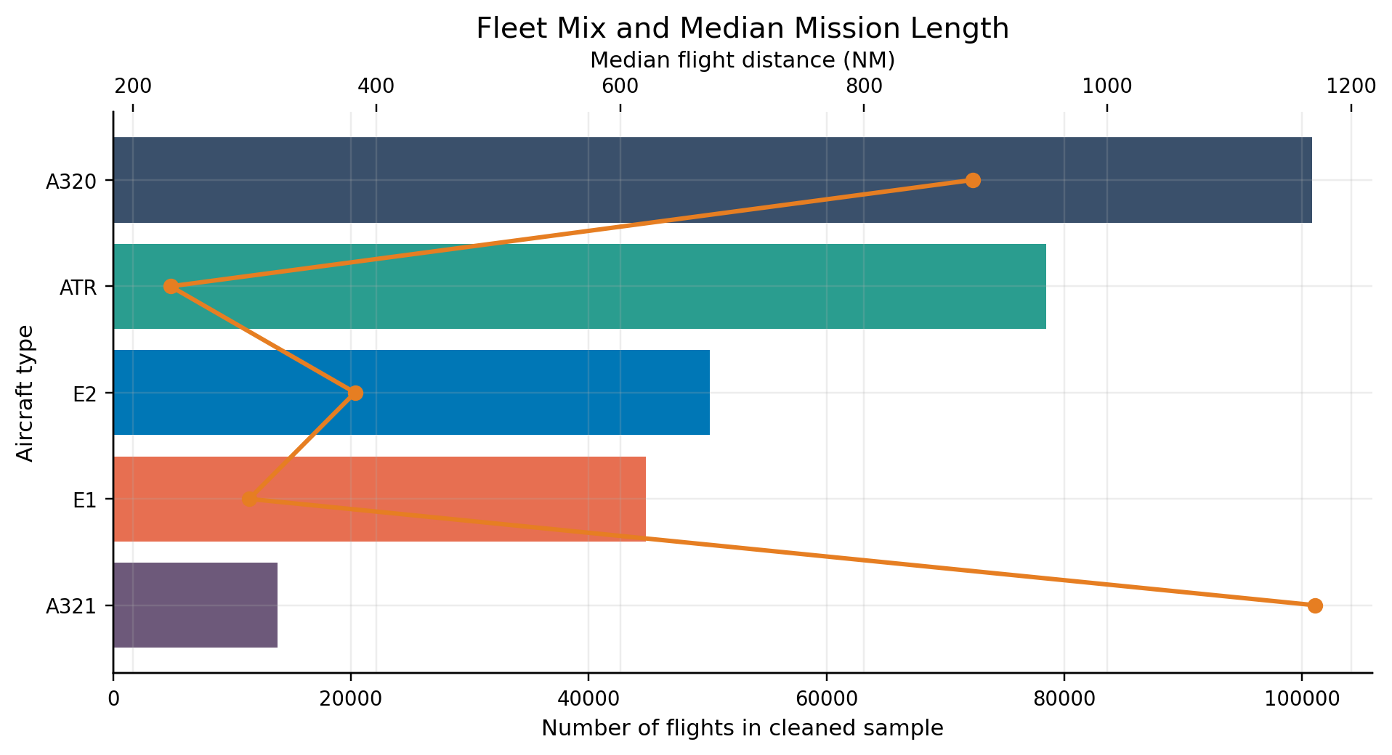
EXPLORATORY ANALYSIS
Exploratory Fleet Profile
Aircraft | Flights | Median distance (NM) | Median TOW (kg) | Median fuel (kg/NM)
ATR | 78,452 | 231.0 | 21,225 | 2.96
E1 | 44,805 | 295.6 | 44,429 | 6.67
E2 | 50,191 | 382.4 | 52,745 | 4.98
A320 | 100,865 | 889.2 | 66,644 | 5.38
A321 | 13,794 | 1,170.4 | 80,116 | 6.01
Fleet families occupy different mission tiers. That is why raw fuel comparisons are not enough: distance, TOW, and aircraft type are entangled.
Conclusion: The next step is controlled comparison inside similar operating conditions.
Sources: Azul_DataSample.xlsx, Azul_Project_Data_2.xlsx, Main Fleet Analysis.ipynb, azul_seasonal_fleet_assignment_v2.py

Slide 6
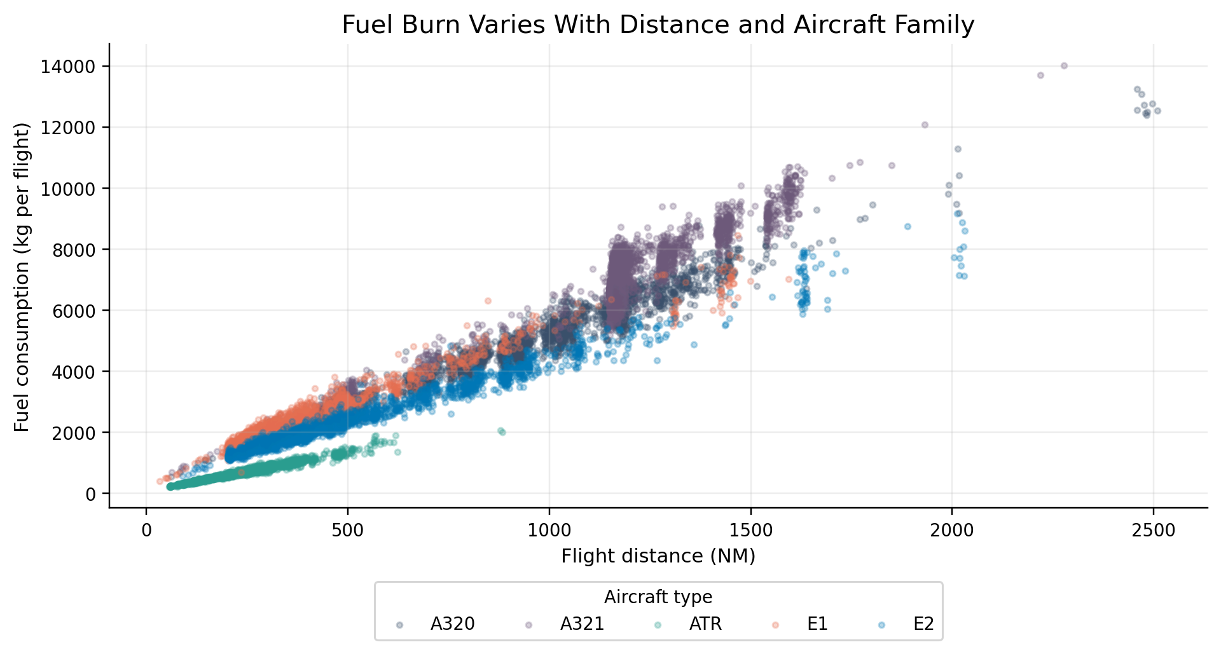
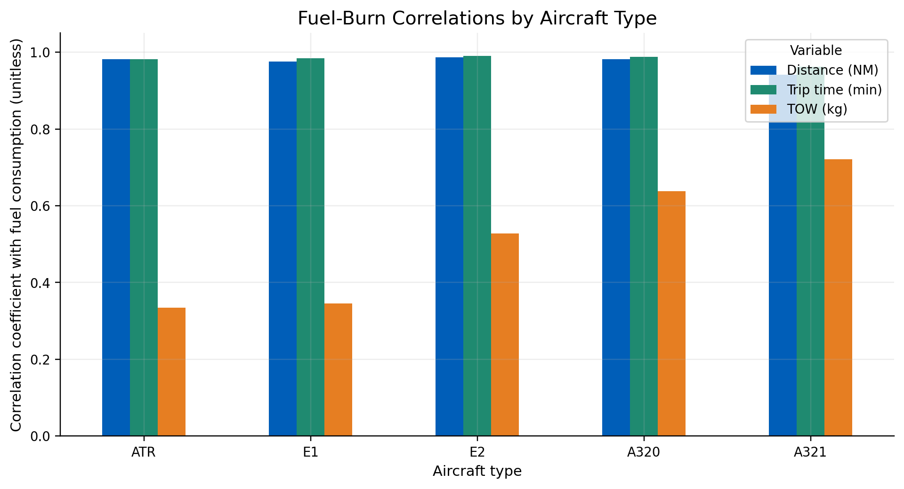
EXPLORATORY ANALYSIS
Why Distance, Time, TOW, and Type Matter
Conclusion: Fuel burn is strongly mission-driven; comparisons must condition on operating envelope before attributing differences to aircraft efficiency.
Sources: Azul_DataSample.xlsx, Azul_Project_Data_2.xlsx, Main Fleet Analysis.ipynb, azul_seasonal_fleet_assignment_v2.py

Slide 7
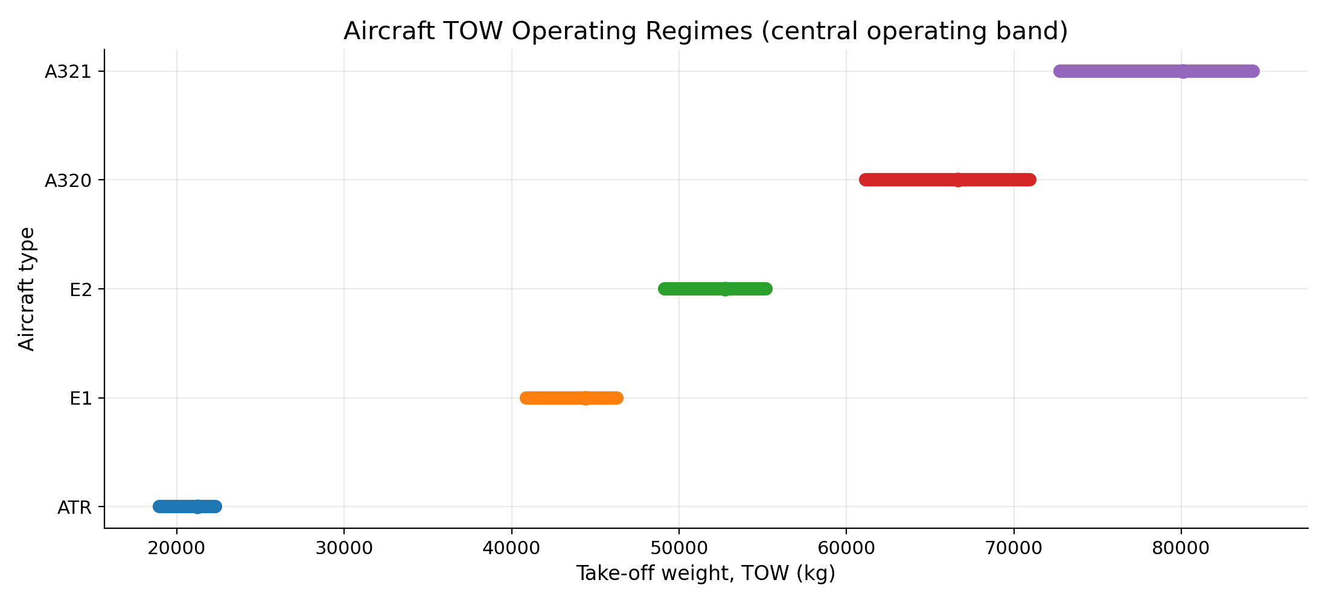
METHODOLOGY
Aircraft Grouping Logic: TOW Operating Regimes
Aircraft | Flights | Low TOW (kg) | Median TOW (kg) | High TOW (kg)
ATR | 78,452 | 18,948 | 21,225 | 22,305
E1 | 44,805 | 40,868 | 44,429 | 46,299
E2 | 50,191 | 49,129 | 52,745 | 55,191
A320 | 100,865 | 61,142 | 66,644 | 70,963
A321 | 13,794 | 72,751 | 80,116 | 84,299
Regime = central TOW band inferred from observed operations.
Route-months are classified against these bands.
TOW is a proxy for aircraft size, payload, and mission assignment behavior.
Conclusion: The fleet separates into clear TOW tiers, supporting aircraft-family-specific comparisons.
Sources: Azul_DataSample.xlsx, Azul_Project_Data_2.xlsx, Main Fleet Analysis.ipynb, azul_seasonal_fleet_assignment_v2.py

Slide 8
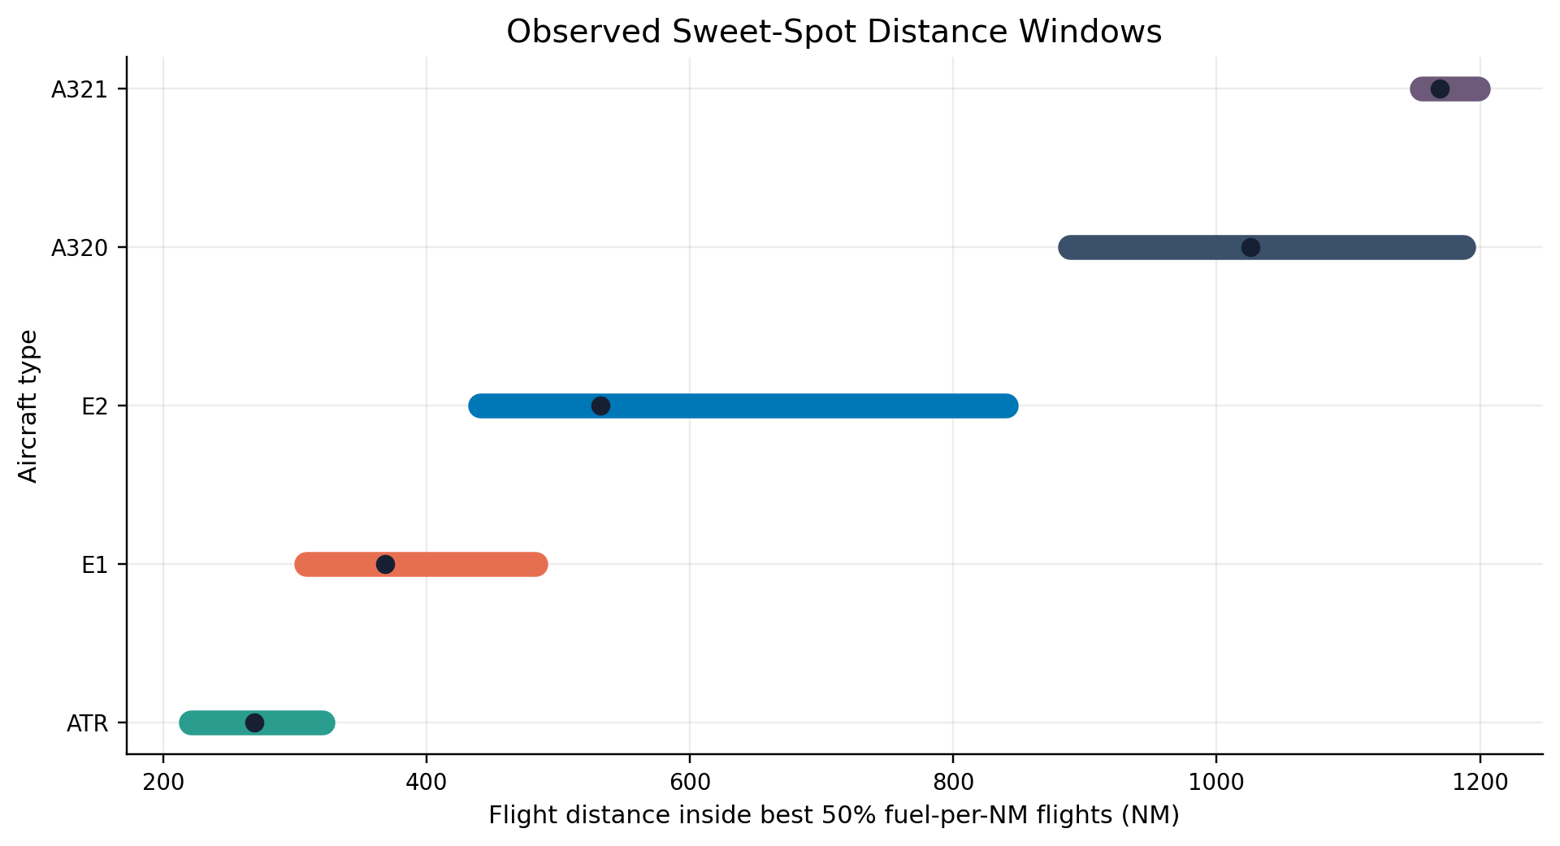
METHODOLOGY
Definition of Operational Sweet Spot
For each aircraft, rank flights by fuel consumption per NM.
Keep the best-performing 50% inside that aircraft family.
Calculate IQR windows for distance, trip time, and TOW.
A joint sweet-spot flight must fall inside all three windows.
This defines comparable observations using observed behavior, not design claims.
Conclusion: The sweet spot is a sample-based operating envelope where aircraft comparisons are less confounded by mission length.
Sources: Azul_DataSample.xlsx, Azul_Project_Data_2.xlsx, Main Fleet Analysis.ipynb, azul_seasonal_fleet_assignment_v2.py

Slide 9
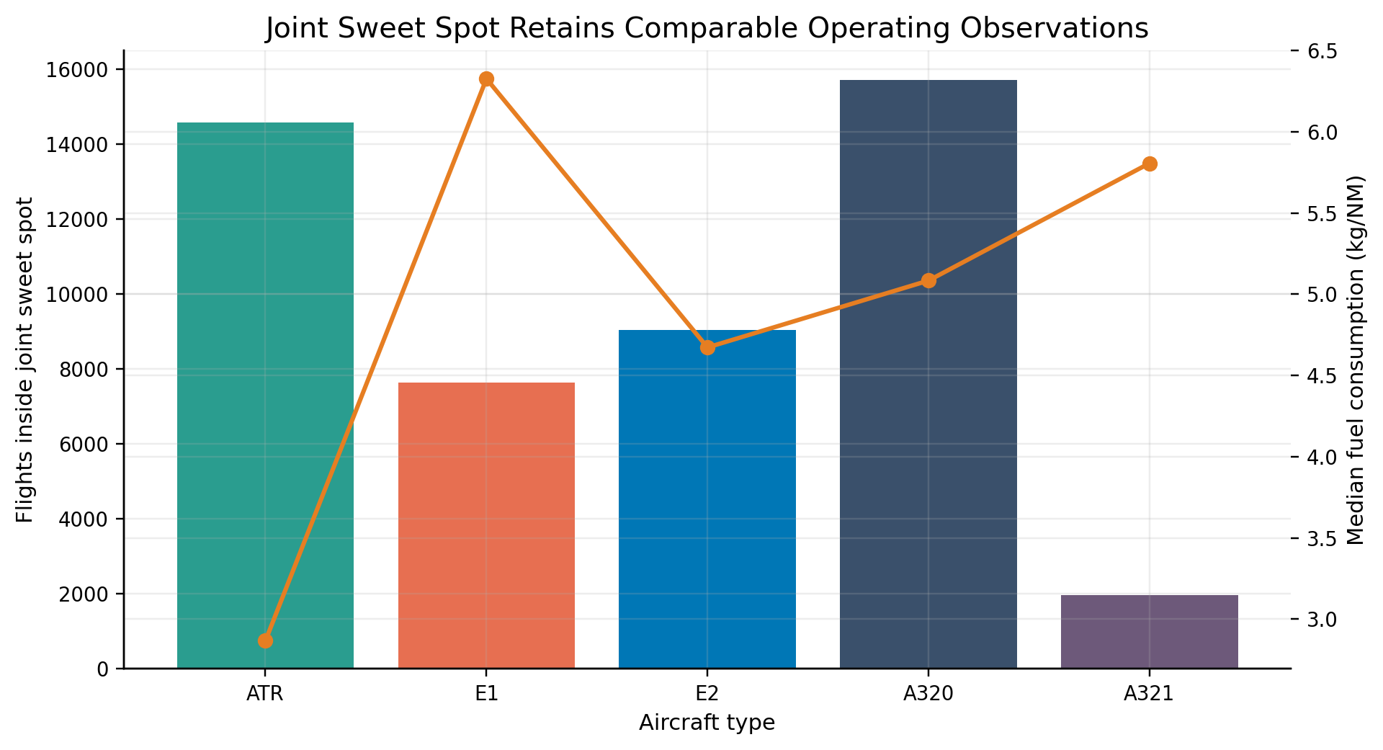
FINDINGS
Joint Sweet Spot Sample
Aircraft | Joint flights | Share of aircraft flights | Median fuel (kg/NM)
A320 | 15,701 | 15.6% | 5.08
A321 | 1,958 | 14.2% | 5.81
ATR | 14,574 | 18.6% | 2.87
E1 | 7,632 | 17.0% | 6.33
E2 | 9,039 | 18.0% | 4.67
This filter intentionally reduces the sample to observations with comparable distance, time, and TOW conditions within each aircraft family.
Conclusion: The route-level screen starts only after this comparability filter is applied.
Sources: Azul_DataSample.xlsx, Azul_Project_Data_2.xlsx, Main Fleet Analysis.ipynb, azul_seasonal_fleet_assignment_v2.py

Slide 10
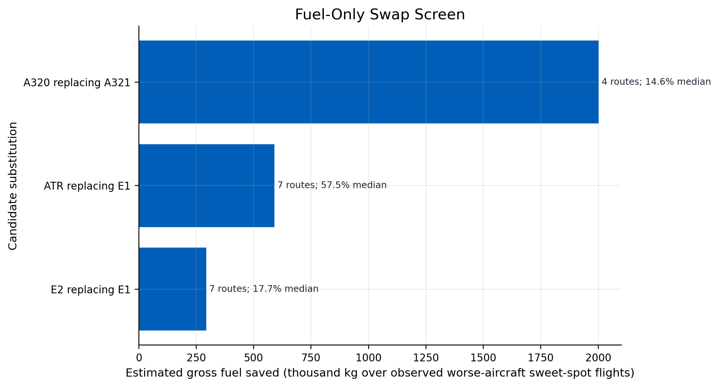
FINDINGS
Overlapping Sweet Spots Identify Fuel-Only Swap Candidates
Fuel-only substitution | Routes | Worse-aircraft sweet flights | Median kg/NM saving
A320 replacing A321 | 4 | 1957 | 14.6%
ATR replacing E1 | 7 | 459 | 57.5%
E2 replacing E1 | 7 | 641 | 17.7%
Fuel-only comparison is a necessary but insufficient screen. It ignores seat supply, slot pressure, aircraft availability, and rotations.
Conclusion: Three directions appear fuel-positive before capacity is considered: A320 for A321, ATR for E1, and E2 for E1.
Sources: Azul_DataSample.xlsx, Azul_Project_Data_2.xlsx, Main Fleet Analysis.ipynb, azul_seasonal_fleet_assignment_v2.py

Slide 11
METHODOLOGY
Seat-Based Swapability Screen
Aircraft | Assumed seats
ATR | 70
E1 | 118
E2 | 136
A320 | 174
A321 | 214
Seat capacity is not a field in the operational dataset. The analysis uses the seat assumptions from Main Fleet Analysis.ipynb as a conservative proxy for maintaining route capacity.
Equal-seat fuel scenario = observed worse-aircraft seat supply / better aircraft seats x better median fuel per flight. This is not a demand model and does not prove frequencies can be reduced.
Conclusion: Seat-based swapability is a feasibility proxy; it screens out fuel-only ideas that fail once capacity is held constant.
Sources: Azul_DataSample.xlsx, Azul_Project_Data_2.xlsx, Main Fleet Analysis.ipynb, azul_seasonal_fleet_assignment_v2.py

Slide 12
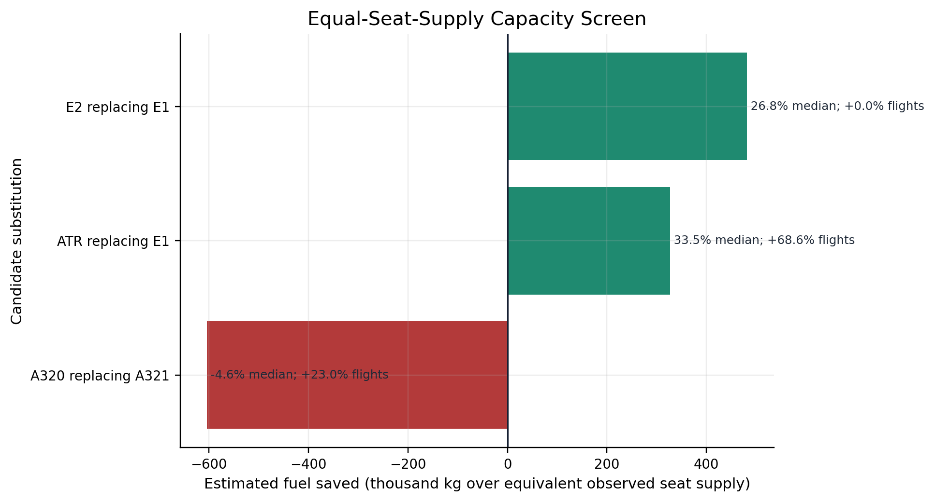
FINDINGS
Capacity Screen Changes the Result
Substitution | Routes | Median extra flights | Median equal-seat saving
E2 replacing E1 | 7 | 0.0% | 26.8%
ATR replacing E1 | 7 | 68.6% | 33.5%
A320 replacing A321 | 4 | 23.0% | -4.6%
ATR-for-E1 remains fuel-positive in the equal-seat math, but needs 68.6% more flights. A320-for-A321 turns negative. E2-for-E1 requires no extra flights because assumed E2 seats exceed E1 seats.
Conclusion: E2 replacing E1 is the only substitution that survives both the fuel and seat-supply screens without extra frequency.
Sources: Azul_DataSample.xlsx, Azul_Project_Data_2.xlsx, Main Fleet Analysis.ipynb, azul_seasonal_fleet_assignment_v2.py

Slide 13
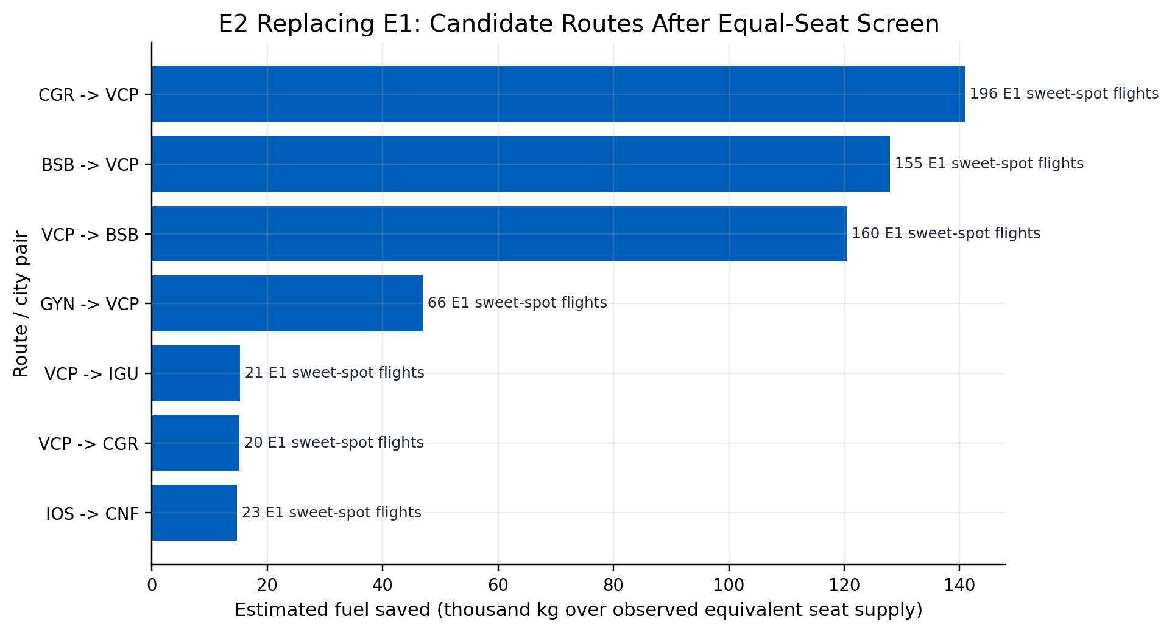
FINDINGS
Route-Level E2-for-E1 Opportunities
7
candidate routes
641
observed E1 sweet flights
26.8%
median equal-seat saving
751
kg per observed E1 sweet flight equivalent
Total modeled saving: 481,443 kg over equivalent observed seat supply. This is not annualized and does not represent total network fuel.
Conclusion: The candidate set is concentrated, measurable, and small enough for engineering validation.
Sources: Azul_DataSample.xlsx, Azul_Project_Data_2.xlsx, Main Fleet Analysis.ipynb, azul_seasonal_fleet_assignment_v2.py

Slide 14
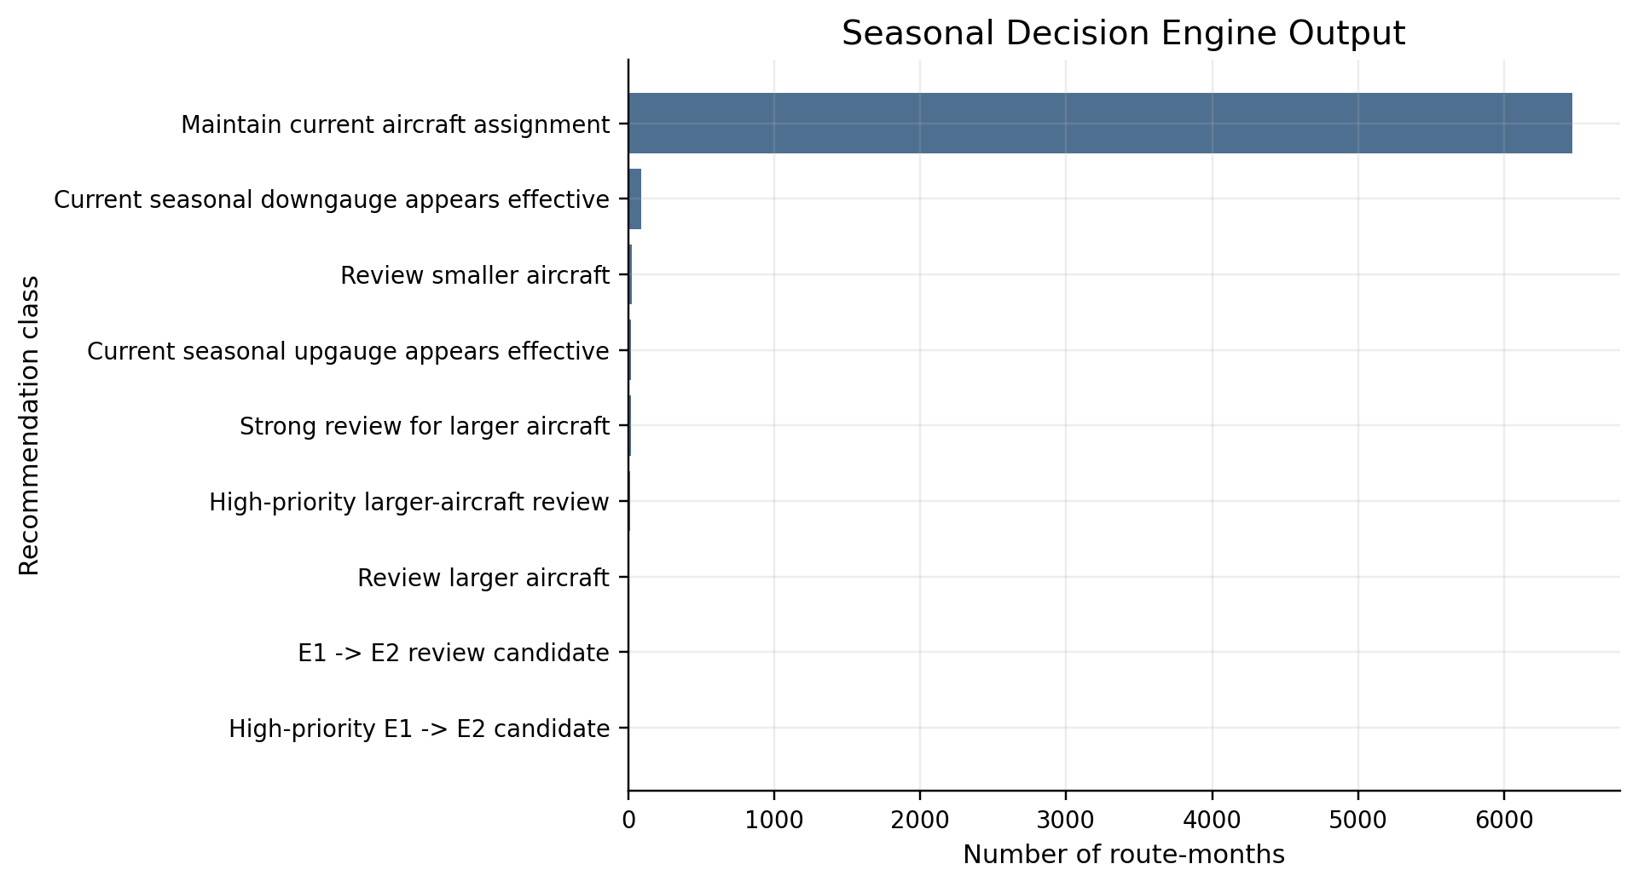
METHODOLOGY
Seasonal Decision Engine Extends the Route Screen
Route-months compare each month against that route's own median.
High frequency threshold: >=25% above route median; very high: >=50%.
Demand proxy threshold: passengers or payload >=8% above route median.
TOW threshold: >=5% shift; fuel intensity threshold: >=4% shift.
E1 -> E2 flag requires E1 primary plus >=3% observed E2 kg/NM advantage on the route.
Conclusion: The seasonal engine identifies timing candidates; the sweet-spot screen identifies structural route candidates.
Sources: Azul_DataSample.xlsx, Azul_Project_Data_2.xlsx, Main Fleet Analysis.ipynb, azul_seasonal_fleet_assignment_v2.py

Slide 15
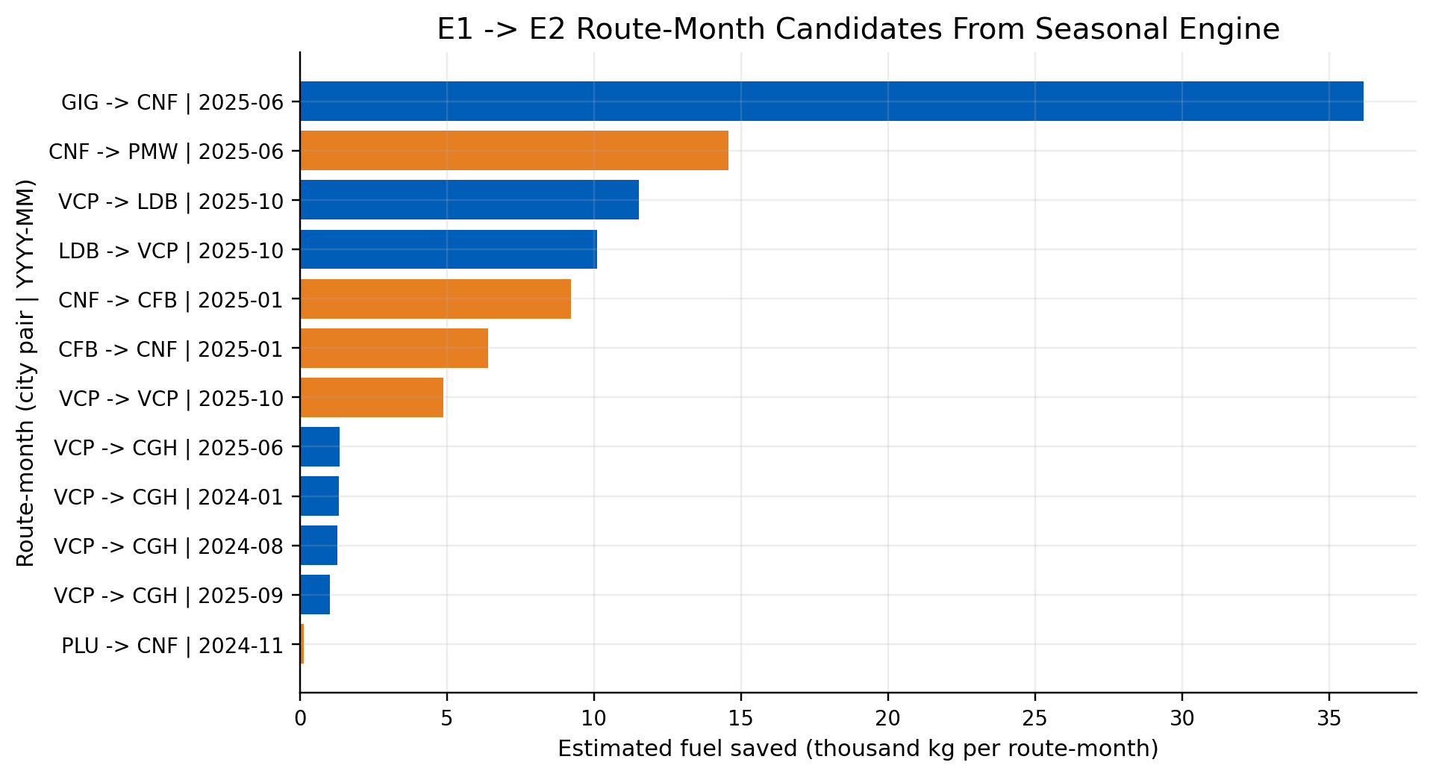
FINDINGS
Route-Month Reassignment Candidates
12
E1 -> E2 route-months
98k kg
sum of kg per route-month
This v2 metric is calculated at route-month level: kg saved = kg/NM difference x average distance x flights. It is separate from the equal-seat sweet-spot estimate.
Conclusion: Seasonal candidates are scheduling review targets, not automatic assignments.
Sources: Azul_DataSample.xlsx, Azul_Project_Data_2.xlsx, Main Fleet Analysis.ipynb, azul_seasonal_fleet_assignment_v2.py

Slide 16
INTERPRETATION
Operational Interpretation
Interpretation layer | Technical meaning
What the evidence supports | Prioritize E2 allocation for E1 route groups where overlap, capacity, and fuel evidence align.
What it does not prove | It does not solve rotations, crew availability, maintenance checks, slots, gates, or day-of-operations disruption.
Why E2-for-E1 is operationally plausible | The E2 carries more assumed seats than E1 and shows lower observed kg/NM in the candidate overlap routes.
Why other swaps are not recommended | ATR-for-E1 needs too many extra flights; A320-for-A321 fails the equal-seat fuel screen.
Treat results as a ranked engineering worklist.
Validate candidate routes inside actual tail rotations before implementation.
Use passenger demand and load factor data to replace the seat-capacity proxy.
Conclusion: The analysis narrows a broad fleet problem into a reviewable set of route and route-month candidates.
Sources: Azul_DataSample.xlsx, Azul_Project_Data_2.xlsx, Main Fleet Analysis.ipynb, azul_seasonal_fleet_assignment_v2.py

Slide 17
ACTION
Recommendations
# | Recommendation | Operational use | Evidence basis
1 | Pilot E2 allocation on seven E1-overlap corridors | Start with CGR-VCP, BSB-VCP, VCP-BSB, GYN-VCP, VCP-IGU, VCP-CGR, IOS-CNF. | Fuel-positive under equal-seat screen.
2 | Run route-month checks before each schedule season | Use v2 route-month flags as pre-schedule review input. | Captures timing and demand proxy variation.
3 | Reject fuel-only swaps without capacity and operations checks | Do not advance A320-for-A321 or ATR-for-E1 from fuel-only output alone. | Capacity and frequency can erase apparent savings.
4 | Track realized fuel against control routes | Compare kg per flight and kg/NM before/after on candidate corridors. | Turns proxy analysis into operating evidence.
Primary recommendation: prioritize incoming E2 frames where the next aircraft entering service has the largest observed fuel benefit under comparable conditions.
Conclusion: Recommendation follows directly from the dual filter: observed overlap plus equal-seat feasibility.
Sources: Azul_DataSample.xlsx, Azul_Project_Data_2.xlsx, Main Fleet Analysis.ipynb, azul_seasonal_fleet_assignment_v2.py

Slide 18
CAUTION
Engineering and Operational Constraints
Constraint | Why it matters
Rotation logic | A segment swap can affect the full tail routing, turn times, maintenance windows, and hub connections.
Crew constraints | E1/E2 commonality helps, but differences training, currency, and captain availability still matter.
Airport constraints | Gate compatibility, ramp handling, slot use, payload limits, and runway conditions need station checks.
Economics | Fuel savings are gross fuel savings; lease, maintenance reserve, crew cost, and ownership cost are not modeled.
Demand | Seat capacity is a proxy. Real demand, load factor, and revenue management data are needed before schedule changes.
Conclusion: The model produces candidate opportunities; Azul operations data must decide implementation feasibility.
Sources: Azul_DataSample.xlsx, Azul_Project_Data_2.xlsx, Main Fleet Analysis.ipynb, azul_seasonal_fleet_assignment_v2.py

Slide 19
CAUTION
Limitations
Fuel burn is observed, but avoidable fuel waste is estimated through counterfactual assignment logic.
Passenger and payload variables are joined averages, not a full flight-level demand or revenue model.
Seat assumptions are fixed by aircraft family and may differ from Azul subfleet configurations.
Sweet spots are sample-defined; thin-overlap routes are excluded rather than inferred.
Airport, crew, maintenance, network rotations, disruptions, and day-of-operation constraints are not modeled.
Financial impact is not net operating margin; cost categories beyond fuel are outside the dataset.
Conclusion: The main conclusion is robust as a fuel-prioritization rule, not as an automated fleet-assignment optimizer.
Sources: Azul_DataSample.xlsx, Azul_Project_Data_2.xlsx, Main Fleet Analysis.ipynb, azul_seasonal_fleet_assignment_v2.py

Slide 20
NEXT STEPS
Next Analytical Steps
Step | Workstream | Required data or model
1 | Replace seat proxy | Use actual seats by tail/subfleet, booked demand, load factor, no-show and spill data.
2 | Rotation feasibility | Build tail-rotation constraints across all legs touched by candidate routes.
3 | Airport screen | Gate, runway, slot, turnaround, ground equipment, and payload restriction validation.
4 | Net economics | Add lease, maintenance reserve, crew, ownership, delay, and schedule utility impacts.
5 | Pilot measurement | Run controlled before/after comparison using kg per flight and kg/NM by route-month.
Analytical end state: a constrained fleet-assignment optimizer seeded by the E2-for-E1 opportunities found here, then validated against real operating constraints.
Conclusion: The next model should move from candidate identification to constrained implementation.
Sources: Azul_DataSample.xlsx, Azul_Project_Data_2.xlsx, Main Fleet Analysis.ipynb, azul_seasonal_fleet_assignment_v2.py

Slide 21
REVIEW
Quality Check
Check | Deck status
Linear story | Problem -> data -> filters -> sweet spot -> overlap -> capacity -> route-month -> action
Units | Fuel in kg, distance in NM/km where stated, TOW in kg, route-months counted explicitly
Denominators | Per flight, per NM, per route-month, or observed equivalent seat supply stated on visuals
Support | Conclusions trace to generated CSVs, notebooks, and patched Python engines
Caution | Proxy assumptions and missing operational constraints called out before recommendations
Final engineering interpretation: candidate opportunities are real enough to validate, but not final reassignment decisions without Azul's operational constraint data.
Conclusion: The recommendations follow from the evidence chain and stay within the limits of the available data.
Sources: Azul_DataSample.xlsx, Azul_Project_Data_2.xlsx, Main Fleet Analysis.ipynb, azul_seasonal_fleet_assignment_v2.py

